Slide 1
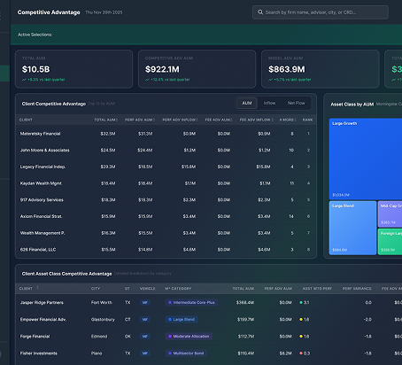

Distribution Intelligence
Strictly Private and Confidential · 2026

Slide 2

This is Field
WHAT FIELD IS
WHAT FIELD IS NOT
The universal data layer for wealth management. Every household in an advisor’s practice, continuously connected across custodians, platforms, and asset types. Intelligence above the data. Connection to the systems that execute.
A hosting platform. Field does not compete with Envestnet, Orion, GeoWealth, or SmartX. Those platforms have earned their position. We create a fabric above them.
THE DATA LAYER
Every household, one record, continuously connected across custodians, platforms, and asset classes
Unified Data
FIELD WEALTH INTELLIGENCE · CONFIDENTIAL

Slide 3
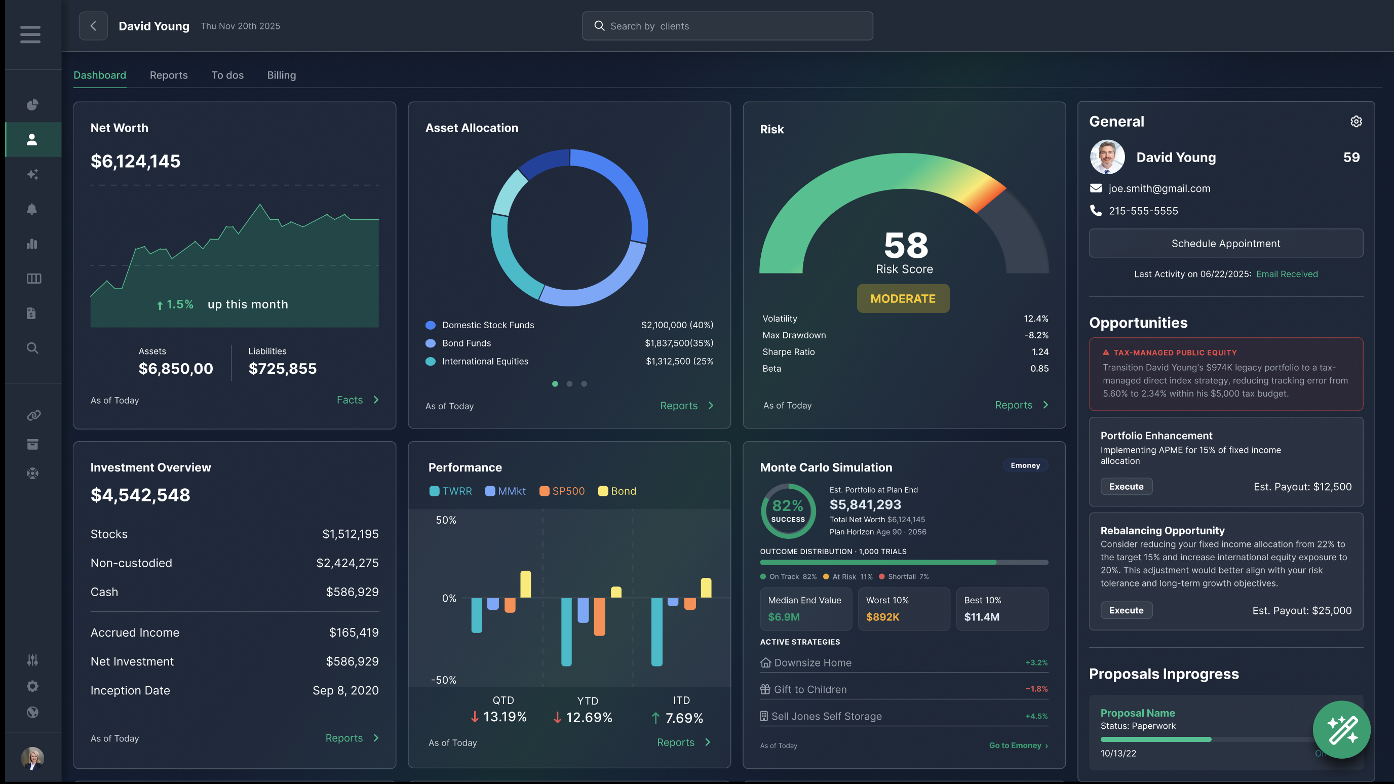
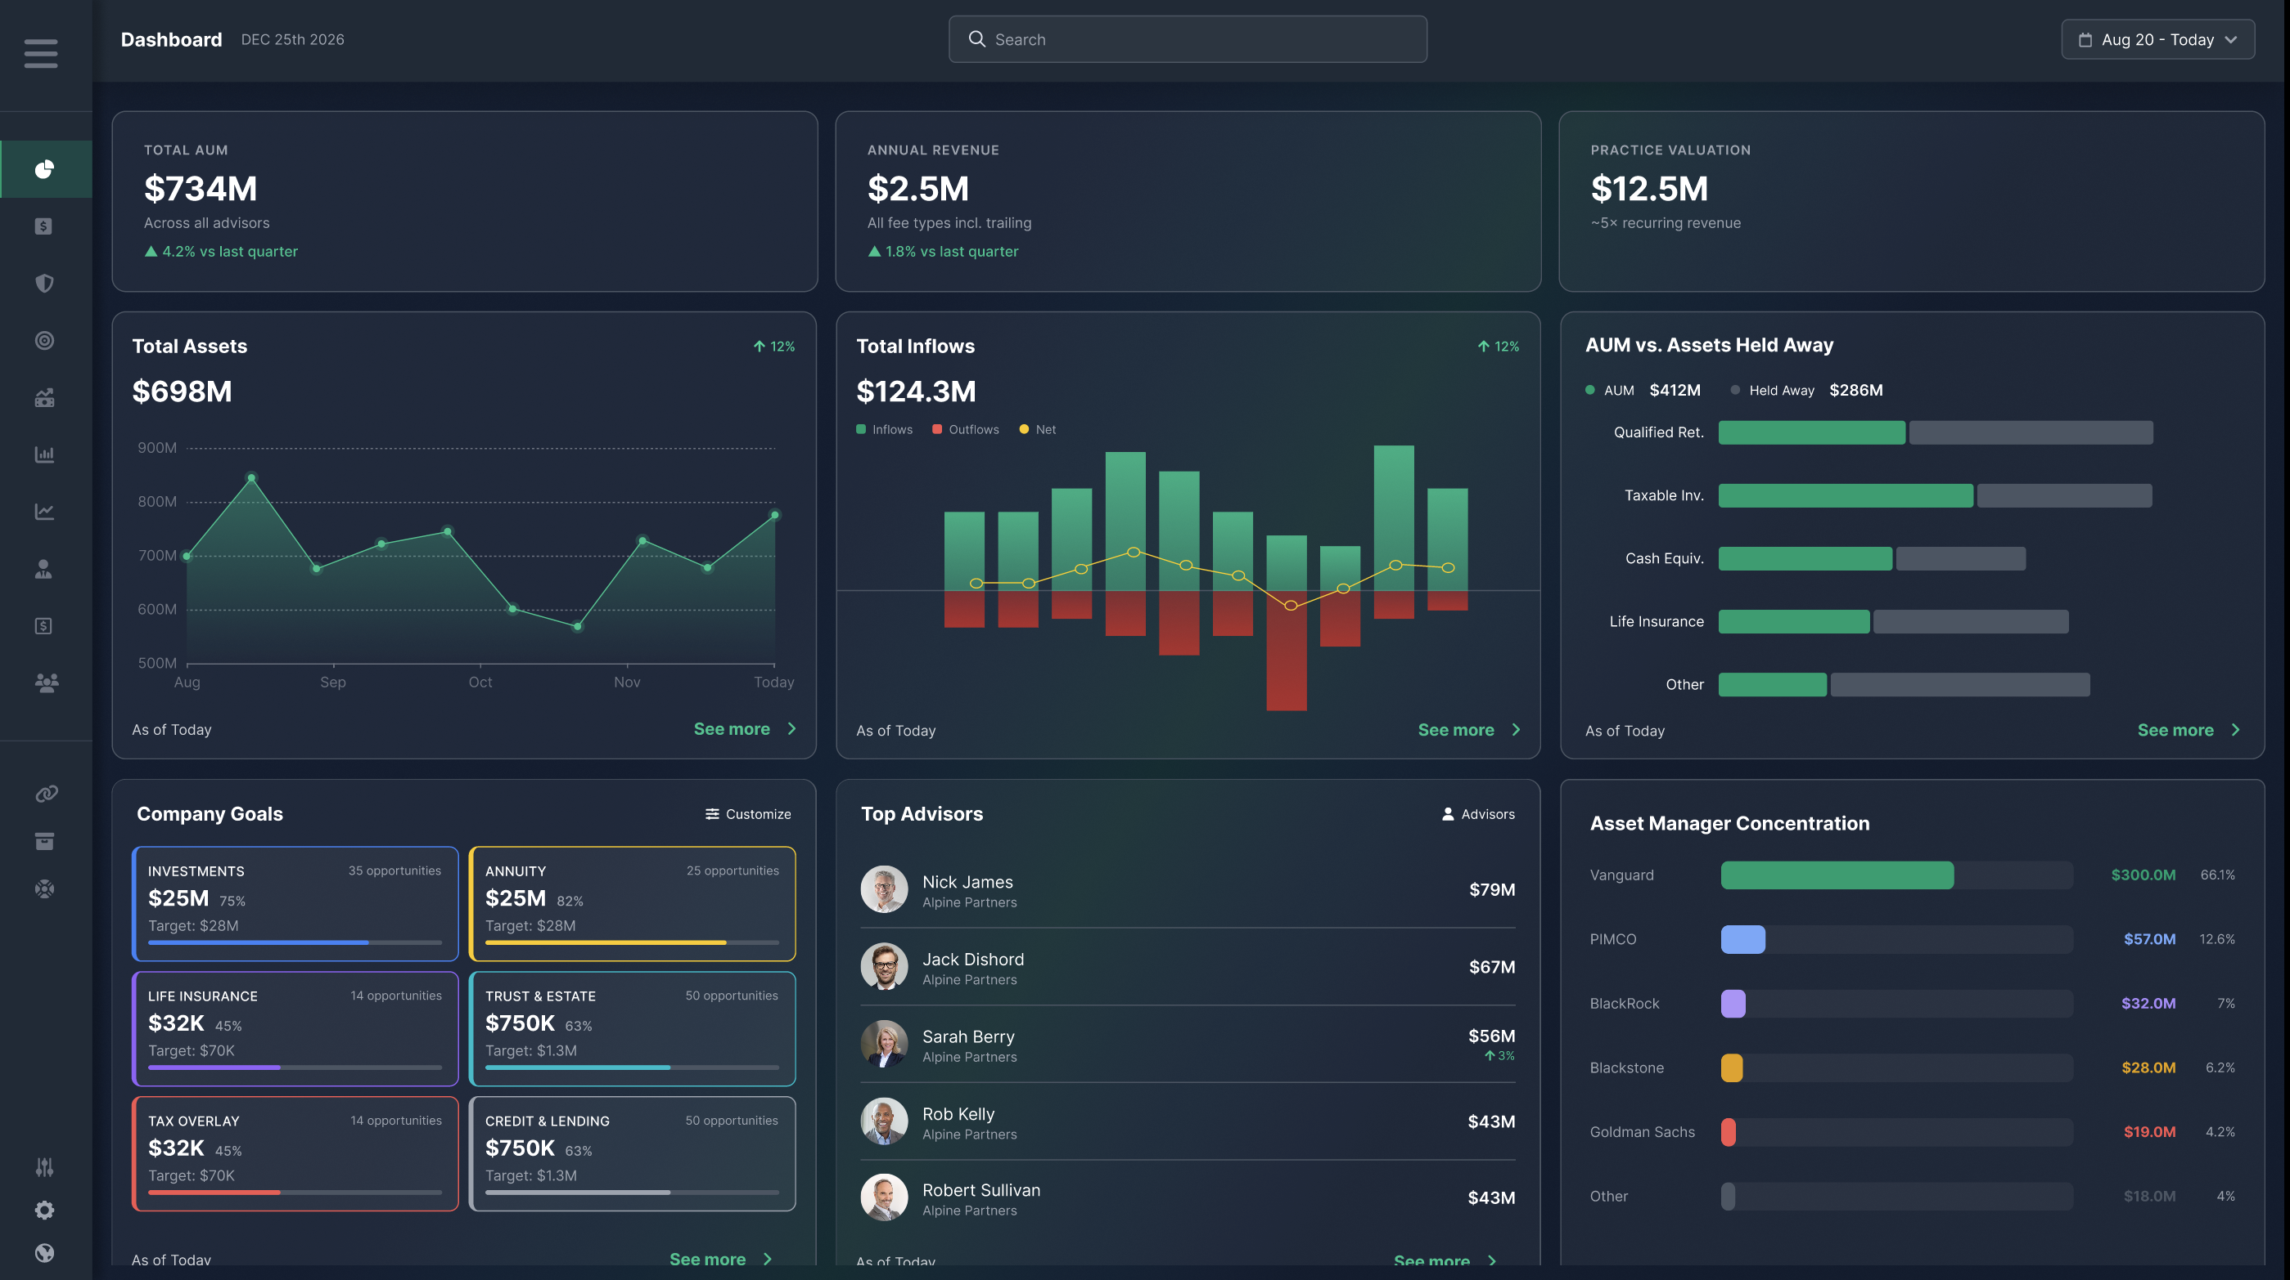
Modern Practice Management
Advice
Business
INTELLIGENCE ENABLED
THE DATA LAYER
Unified Data
Golden Record · Entity Resolution · Growth Signals · Risk Alerts · Full Audit Trail
ECOSYSTEM
Wealthtechs
Asset Managers
Capital Providers
FIELD WEALTH INTELLIGENCE · CONFIDENTIAL

Slide 4
$1M+ Invested in the Data. Still Flying Blind.
The median asset manager subscribes to 6+ data packs and still can’t act on what they buy.
THE INVESTMENT
THE CAPACITY GAP
THE RESULT
6+
60%
86%
Data packs subscribed
Spent cleaning data
Don’t use the data they buy
The median asset manager. Rarely operationalized.
Most of it goes to their own sales and AUM numbers, leaving little to no capacity for the data packs they’ve invested in.
No precision on advisor quality, territory plans run on guesswork, and competitive moves surface months late.
Source: Ignites, Data Packs: Bigger Bites for Smaller Managers? 05_28_25. Data team capacity: Field Distribution Intelligence whitepaper, 2026, citing dbt Labs & O’Reilly, "Structured for Intelligence," 2026.

Slide 5
The Pressure to Adopt AI Is Real and Accelerating
AI is the accelerant, not the architecture. The data underneath it is the problem, and that is why so many projects fail.
THE FAILURE RATE
THE COST
THE CANCELLATIONS
80%+
$12.9M
40%+
of AI projects do not succeed
average annual cost of poor data quality
of agentic AI projects canceled by end of 2027
Nearly double the failure rate of traditional IT projects. The root cause is almost always bad data.
Per organization, per Gartner. Some firms lose up to 6% of annual revenue to flawed AI outputs.
Gartner cites high costs, weak risk controls, and unclear objectives. All are data foundation problems first.
AI is only as good as the data underneath it. Field delivers that foundation on day one.
Source: Structured for Intelligence, O’Reilly Media and dbt Labs, 2026. Gartner research as cited.

Slide 6








The Intelligence Layer
Wirehouse & BD Data
FA Analytics Dashboard
Consortium Packs
Territory Intelligence
Normalize
ADV · 13F · BrokerCheck
Synthesize
"Ask Field" AI Queries
Distribution Data
Activate
CRM Writeback API
Network Data
Semantic Layer
DATA SOURCES
INTELLIGENCE OUTPUTS

Slide 7
Every Pack Speaks a Different Language
No shared vocabulary, no shared grain, no shared coverage. Every pack was built to stand alone.
01
Different grains
02
Inconsistent coverage
03
Overlapping coverage
One pack reports at the advisor level, the next at the branch, a third at the team.
One pack captures mutual funds in detail. Another covers ETFs at a different scope, frequency, and classification.
Broker dealer and consortium packs cover the same firm from different angles, and the overlap risks double counting.
THE RESULT
Assembling one coherent view of territory opportunity across every subscribed pack takes a reconciliation methodology on top of the engineering.

Slide 8
One Unified Data Set
Every pack, every grain, in one connected schema and mapped to your team and territory structure.
Unified schema
The most granular buying unit available, with FA level data preserved across all packs.
NOTHING OF VALUE DROPPED
Hierarchy resolved
Every field of value preserved
Branch feeds deduplicated and mapped to teams and advisors, office context preserved.
Best Piece selection
For each dimension, the highest quality source wins across packs and public filings.
Every attribute makes it through, no matter how you handle these packs today. Firm specific detail is carried through into one denormalized schema, joined on CRD.
FA Attribution
Office totals allocated to FAs by Machine Learning, then rolled up to the team or buying unit.
Cadence and drift managed
One schema. Built around how your sales organization covers the market.
Native cadence respected per pack. Field absorbs schema changes and version drift.
Forward visibility
Emerging packs flagged early, with integration paths already mapped.

Slide 9
Best Piece + FA Attribution, in Practice
Best Piece picks the strongest pack per advisor. FA Attribution allocates the rest down to the individual, or infers it entirely.
BEST PIECE
Advisor John Smith at LPL
DIRECT
ATTRIBUTED
SYNTHESIZED
Mutual Fund
+
ETF
+
Competitive Advantage
LPL pack, FA native. $175M, Morningstar category detail.
Broadridge Market Intelligence. $625M branch, $105M to John’s share.
SS&C Teams data for John’s team, used since his direct pack lacks it.
= One row for John Smith. Every piece traced back to its source.
FA ATTRIBUTION
Same LPL branch, ETF data
SIGNAL WEIGHTS THAT SCORE EACH FA (ILLUSTRATIVE)
OFFICE TOTAL ALLOCATED TO EACH FA
Tenure (FINRA)
.28
LPL Branch
Smith
17% · $105M
Barron’s ranking
.24
Chen
34% · $210M
Home office list
.19
$625M, Broadridge
Prior BD AUM
.14
Park
28% · $175M
Designations
.10
Focus areas
.05
Reid
22% · $135M
One consistent record per advisor, direct or allocated.

Slide 10
AI Ready: Semantic Layer and MCP Server
A documented semantic layer and governed MCP server make the unified data immediately usable by any compliant AI tool.
Documented field catalog
TIME TO VALUE
Every data element defined per pack, with valid values, joins, lineage, and source of record notes.
12 to 18
Shared vocabulary
Metrics, hierarchies, and identifiers mean the same thing to every tool, every agent, and every analyst.
months of internal data work eliminated
Governed MCP access
That is what it typically takes a domain expert team to make distribution data AI ready in house. Field delivers it as a durable asset that compounds in value as packs and models are added.
Scoped, audited, AI ready access so copilots and agents query the data with full context.
Built into your AI workflows
Plug the MCP server into internal copilots, agent frameworks, and analytics assistants from day one.

Slide 11
What Clean Data Does For Sales Leaders
What sales leadership gains once the data is unified.
01
Comprehensive territory view
02
Dashboards leadership can act on
Every opportunity across the territory in one place, not scattered spreadsheets or acting on intuition, so reps spend their time on the best opportunity instead of finding it.
Management sees opportunity versus coverage, not just their own sales and activity counts, and can allocate resources accordingly.
03
Earlier competitive signal
04
Faster wholesaler ramp
Track money in motion and spot the opportunity to gain market share while there’s still time to act, not months after the flows already happened.
New hires inherit territory intelligence on day one, instead of combing through old CRM notes or relying on memory.
05
Competitive advantage
06
Right level for every role
Performance and fee advantage attributed to advisors and teams.
Management, strategic accounts, wholesalers, and marketing each get insights at the level they need.
07
A compounding sales asset
08
Territory optimization
The same foundation gets sharper as CRM data, propensity scores, and new packs are added.
Rebalance coverage around real opportunity while keeping disruption to existing relationships to a minimum.

Slide 12
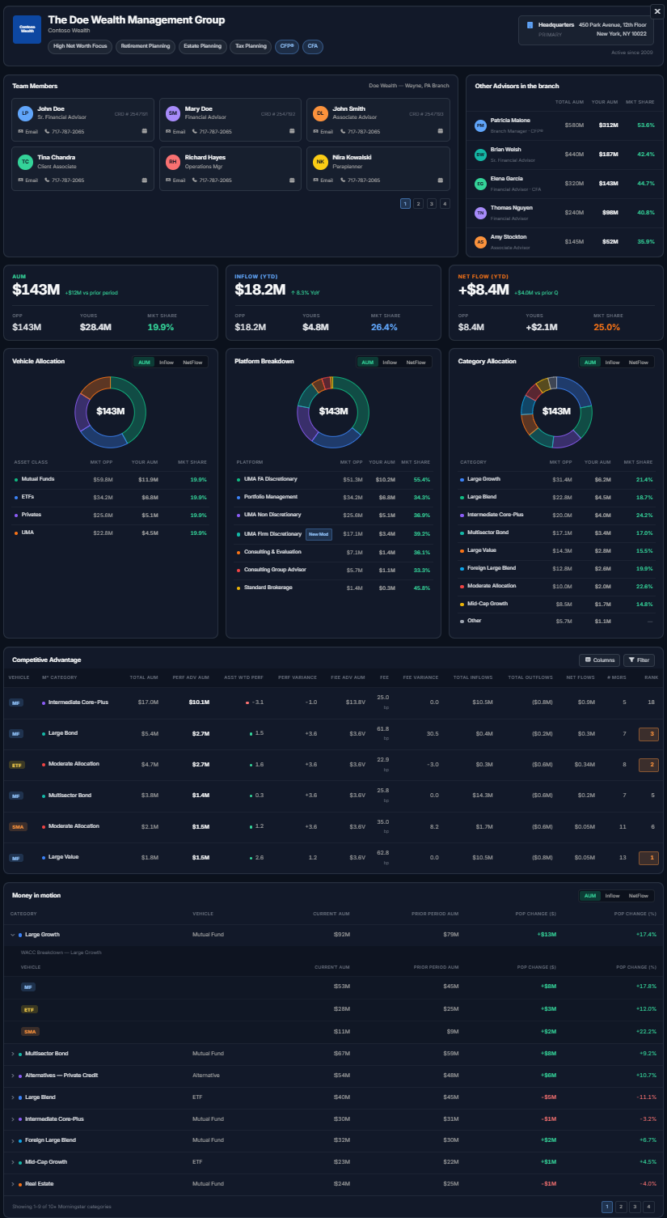
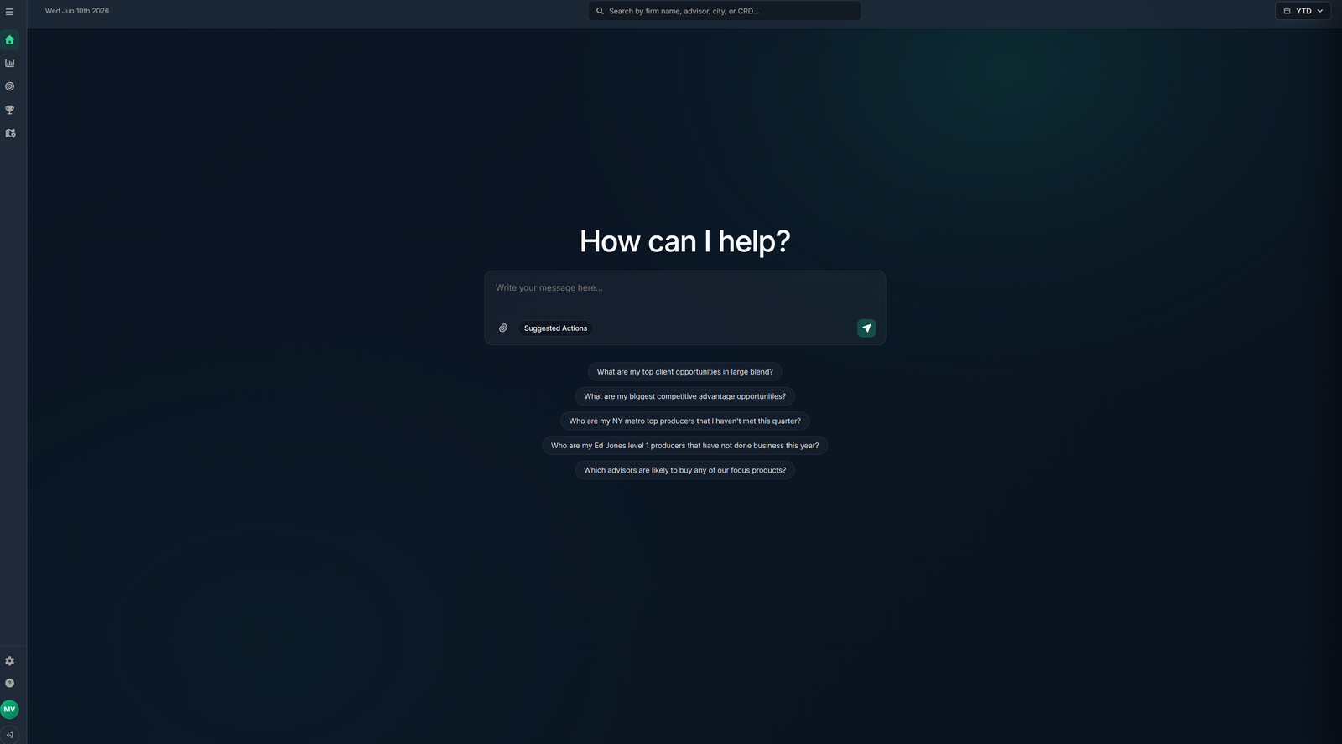
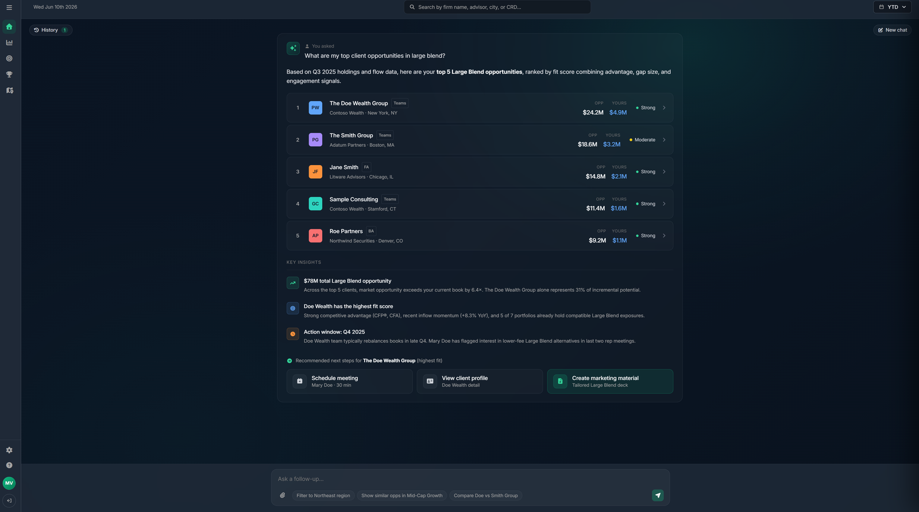
Ask a Question. Get a Client Ready Answer.
Plain English questions over every pack, with results that drill straight into advisor detail.
Ask Field. An interactive AI agent with suggested prompts, or simply ask in plain English.
Results. Ranked answers with key insights, ready to drill into the client detail page.
Client detail. A single view of the advisor or team: allocation, your competitive advantage, and money in motion versus prior periods.

Slide 13
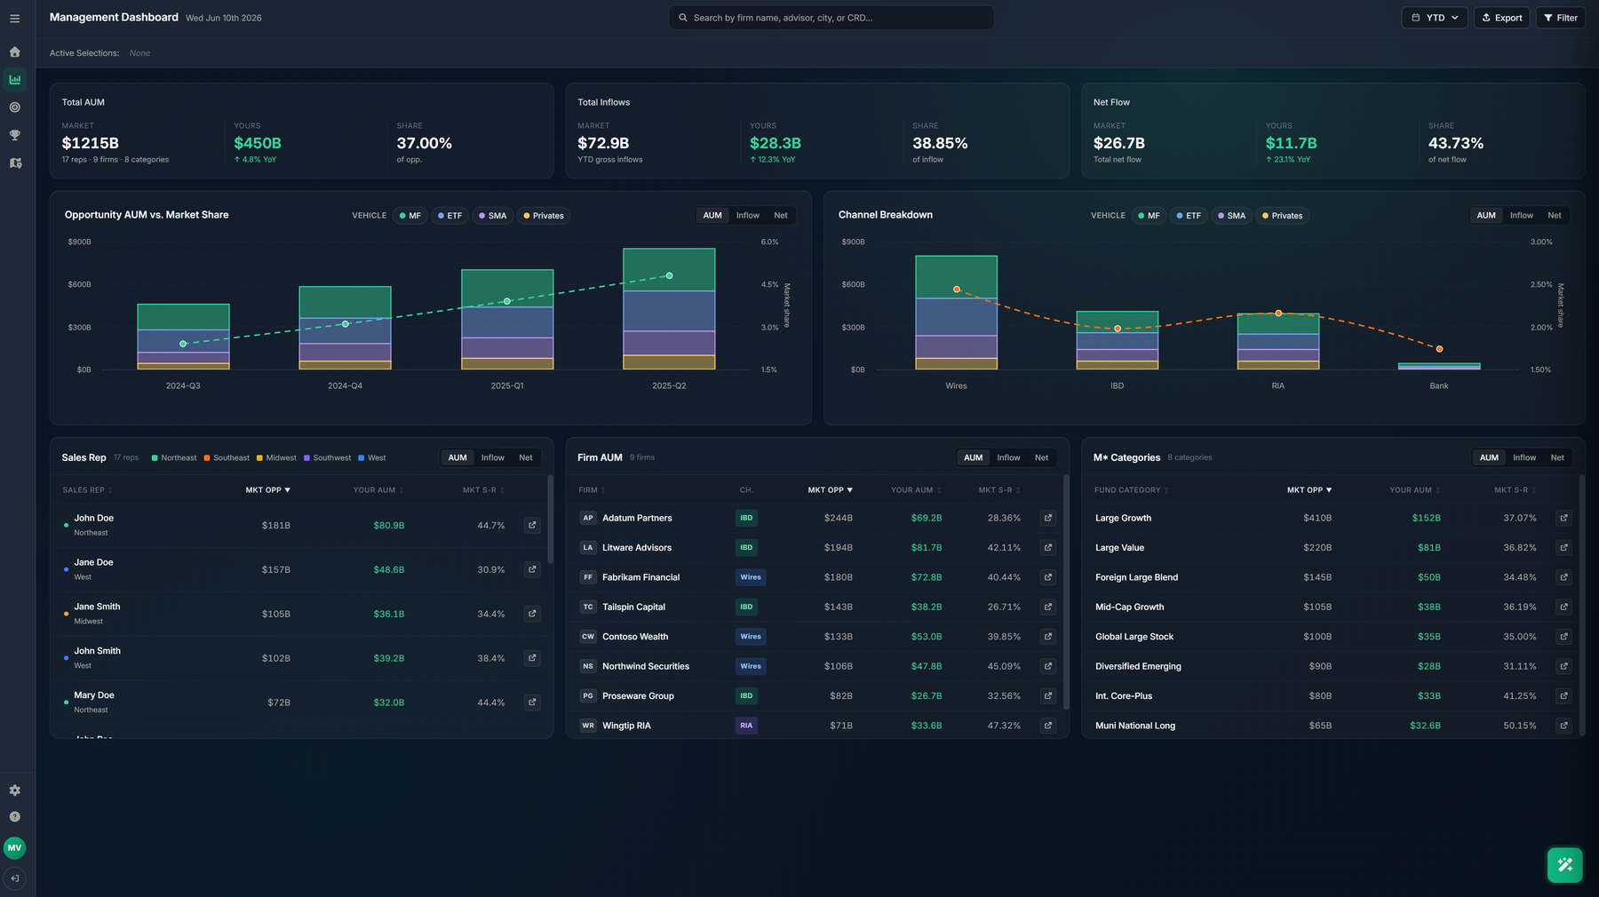
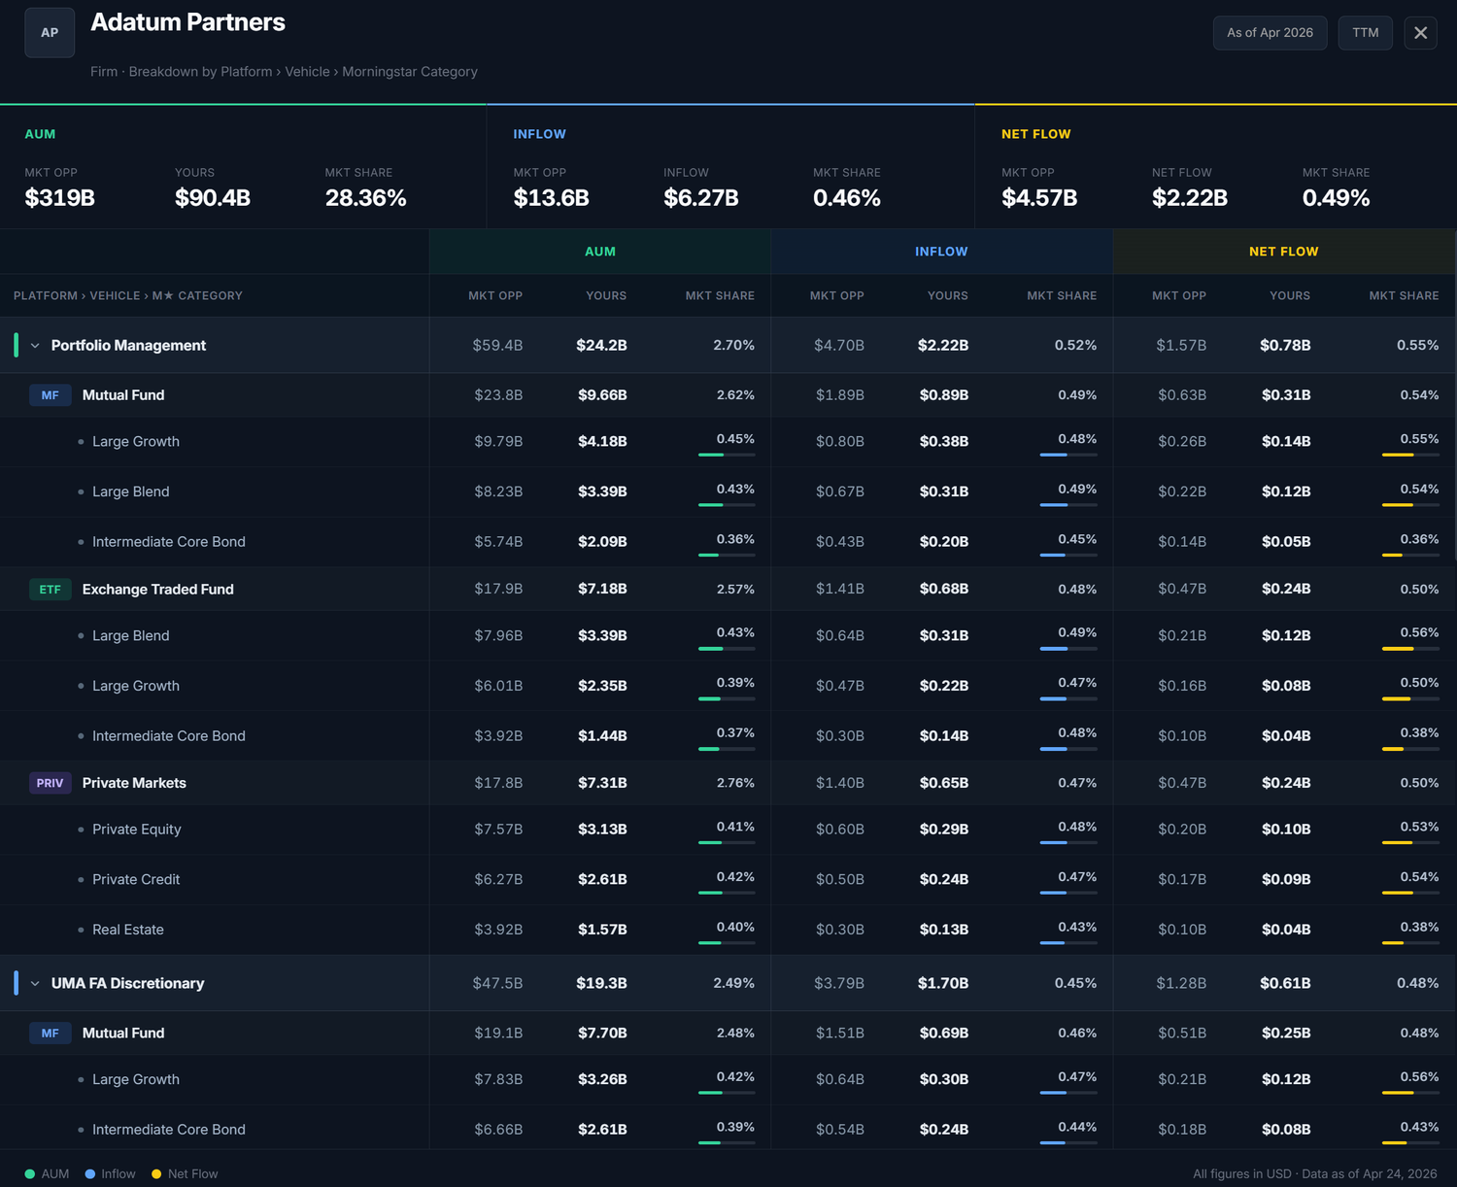
Built for Leadership
Total opportunity across all packs, your portion, and market share by AUM, inflows, and net flows. Fully interactive, filter any way you need.
Management view. One unified view across the entire sales team. Stack rank the team, or isolate a salesperson, firm, vehicle, or asset class for deeper insight.
Firm view. Any firm in depth, broken down by platform, vehicle, and asset class.

Slide 14
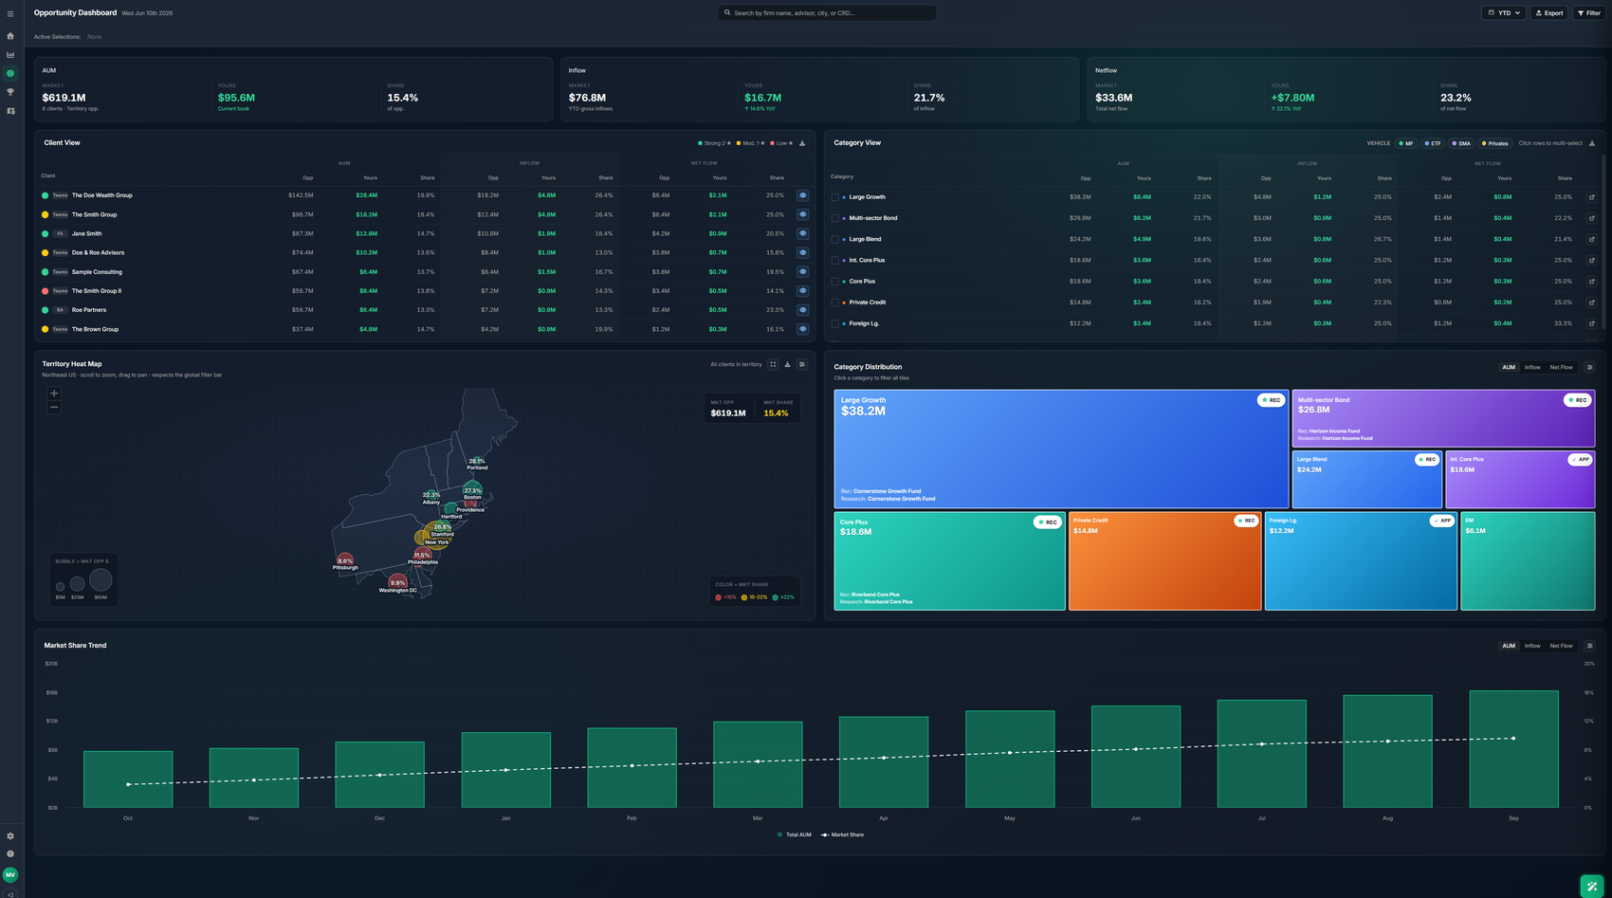
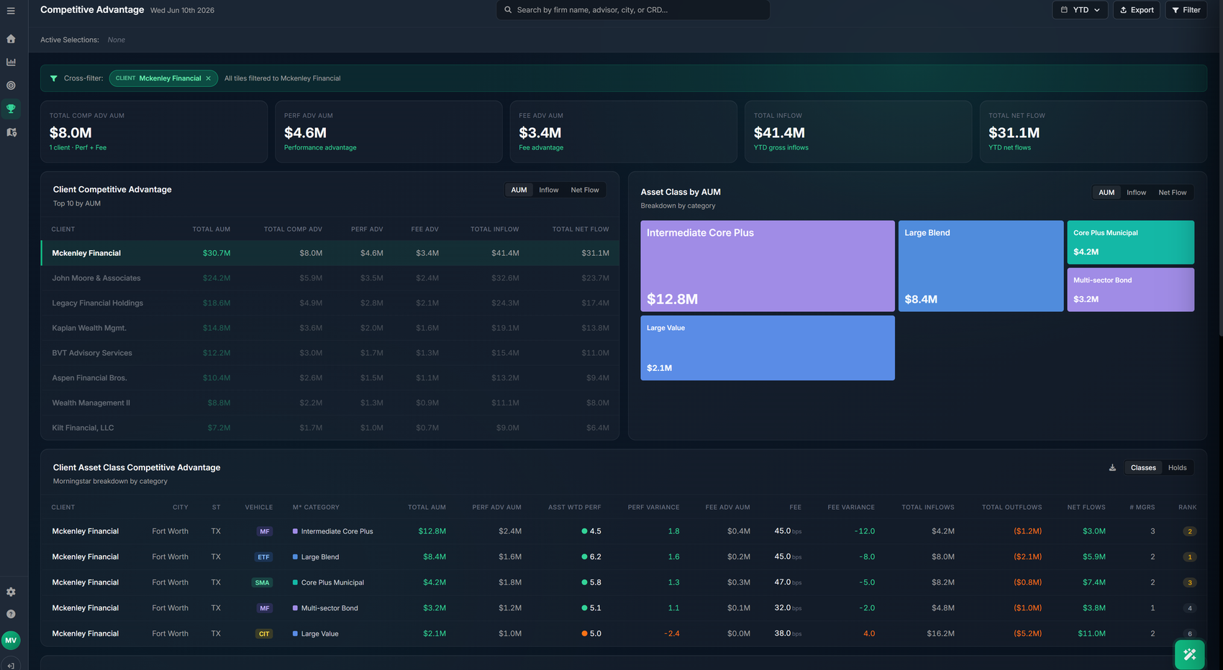
Built for Wholesalers
Territory depth without the spreadsheet work. The best opportunities across every subscribed pack.
Opportunity dashboard. Unified data at the FA level, fully interactive. The heat map shows opportunity and market share across the territory. The tree chart shows focus products and availability.
Competitive advantage. Where you win on performance or fees versus what the advisor holds today. Isolate a client or category for breakdowns by vehicle, advantage variance, and rank.

Slide 15
The Foundation Compounds
Additional levels extend the same unified data set, semantic layer, and MCP server. Nothing gets rebuilt.
LEVEL 2
LEVEL 3
Advisor and Team Intelligence
Propensity and Targeting
Commercial data blended. Your sales, AUM, and CRM activity joined with the market view for timely sales attribution.
Deeper segmentation. Multi attribute scoring designed with your analytics group, beyond a simple top decile cut.
Closed loop tracking. Distribution effectiveness measured from opportunity identified to action executed.
Propensity models. Propensity, market basket, and regression models tuned by Field data science.
CRM writeback. Scores and insights delivered into existing workflows via API. No new UI required.
Prescriptive targeting. The right opportunity surfaced at the right time, for the products you care about most.
One durable asset that compounds in value as packs, commercial data, and models are added.

Slide 16
Why Field
Three decades of distribution data expertise, activating your existing investment in a foundation built to compound
30 years
4.5x Sales Lift
89% Conversion
Distribution domain expertise
Per activity on segmented advisors
Up from 59% using ML algos
AI Ready Data
Engineering
Foundation delivered
Remains focused on your strategic priorities

Slide 17
Live in About 90 Days
Milestones and durations, not a science project. The semantic layer and MCP server build in parallel with the pipelines.
CONNECT
EVALUATE
DESIGN
BUILD
DELIVER
Data share
Pack profiling
Blending logic
Pipelines and MCP
Dashboards, handoff
1 week
2 weeks
3 weeks
4 weeks
3 weeks
Snowflake data share stood up or AWS/SFTP drop box established. Packs and team mappings flow in.
Each pack profiled for grain, coverage, and known gaps, with the resolution approach agreed jointly.
Entity resolution rules, allocation logic, Best Piece selection, and the unified schema.
Normalization pipelines with quality controls. Semantic layer and MCP server built in parallel.
Dashboards and Ask Field configured with your team. Unified data returned via data share.
Kickoff to live platform in about 90 days on your actual data packs and your coverage model.

Slide 18
Your Stack. Your Team. One Data Layer.
Field does not replace your BI tools or your data team. We deliver the unified layer they build on.
FIELD RUNS
YOURS STAYS YOURS
Ingestion and normalization
Your warehouse
Validation, entity resolution, allocation, and blending across every subscribed pack.
The unified, normalized data set returned to your environment via Snowflake data share.
Schema drift and new packs
Your BI tools and in-house AI agents
Quarterly version changes absorbed. Emerging packs flagged with pre-mapped integration paths.
Feed the reports and dashboards you already run. No forced UI, no rip and replace.
Semantic layer, MCP, dashboards
Your engineers
The documented data asset plus the surfaces that make it usable on day one.
Freed from pack plumbing to focus on strategic priorities and AI initiatives.
Maximize the data packs you already pay for. Field runs the plumbing. Your team builds on top.

Slide 19
Next Steps
#
ACTION
WHEN
1
Confirm partnership terms
Partnership level, NDA, Data access
Today
2
Discovery sessions
Data structure and process review
Week 1
3
Field delivers project plan
Timeline
Week 2

